Slide 1
申请经验分享
梁笑
2019.6.5

Slide 2
Background
Recommendation:
Kwee-Yan Teh (Course & TA)
Associate teaching professor & ME Program Advisor
Yunlong Guo ( Research)
Associate Professor, Material
Jaehyung Ju(Course & Research)
Associate Professor, Design and Manu.
Yu Zheng(Course)
Research scientist, Tencent Robotics X
Intern: Yo-i Tech Corporation (IIOT)
Fields: Robotics
Control & Mechatronics
Education: ME @ JI (non-DD)
Overall GPA: 3.78/4.00 ;
Major GPA: 3.93/4.00 Rank: 2/58
Language Tests: (very poor)
TOEFL: 100 (R29 L26 S22 W23);
GRE: 155+169+3.5
Research & Projects:
Wheel-Leg Hybrid Robot
Rheological Behavior of Copolymer
CCD camera imaging
Awards & Scholarships:
Merit Student at SJTU
National Scholarship
Yu Liming Scholarship
Teaching Assistantships: VM395

Slide 3
Application Results
University | Program | APP. Due | First Decision | Results | 定位 （前） | 定位（后）
Univ. of Tokyo | ME MS | Nov. 1st |  | Admission (Full Scholarship) | 平 | 平
USC | Robotics MS | Dec. 15th | Change program | Admission (CS) | 保 | 保
Stanford | ME MS | Dec. 15th | reserve | Rejection | 冲 | 冲
UM | ME MS (JI-SUGS) | Jan. 15th | withdraw | Admission (??? | 保 | 保
UTA | ME MS | Dec. 1st | withdraw | Admission (??? | 冲 | 平
Cornell | ME MS | Dec. 15th | withdraw | --- | 平
ETH | ME MS | Dec. 15th | withdraw | --- | 平
Purdue | ME MS | Dec. 15th | Reserve & Change program | Admission (ME+EM=PMP | 平 | 平

Slide 4
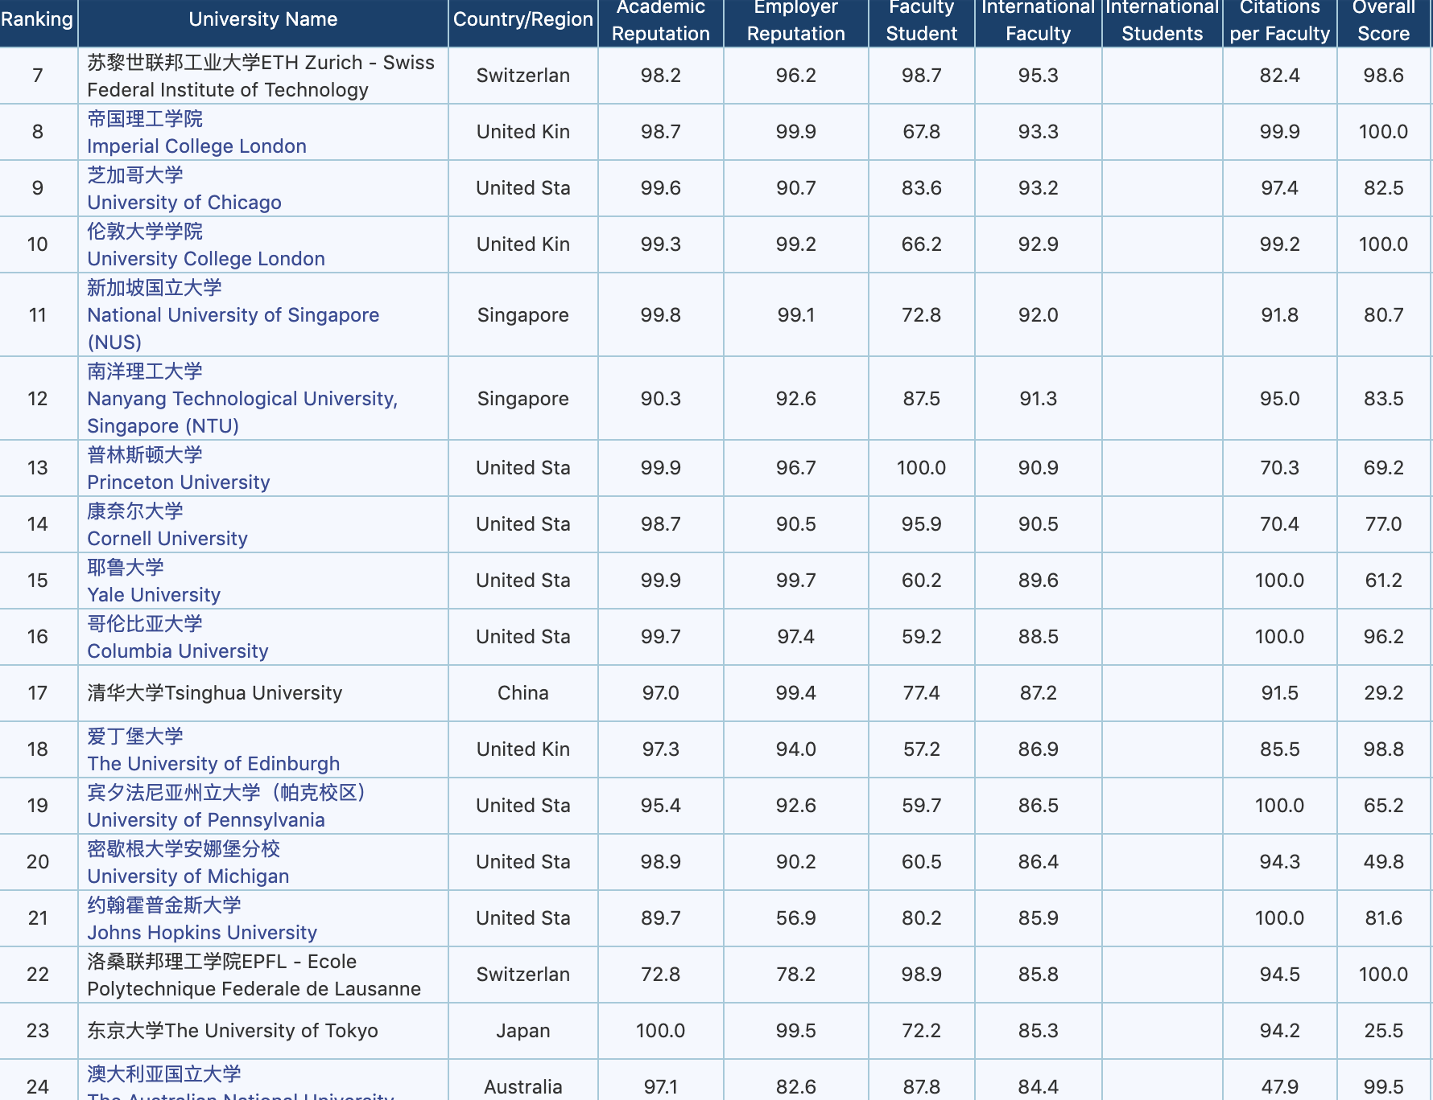
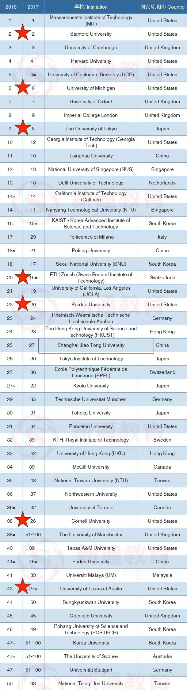
University Major Rank？ Overall Rank？
专排是重要参考；（可选区间小）
学校排名是基础。（可选区间大）

Slide 5
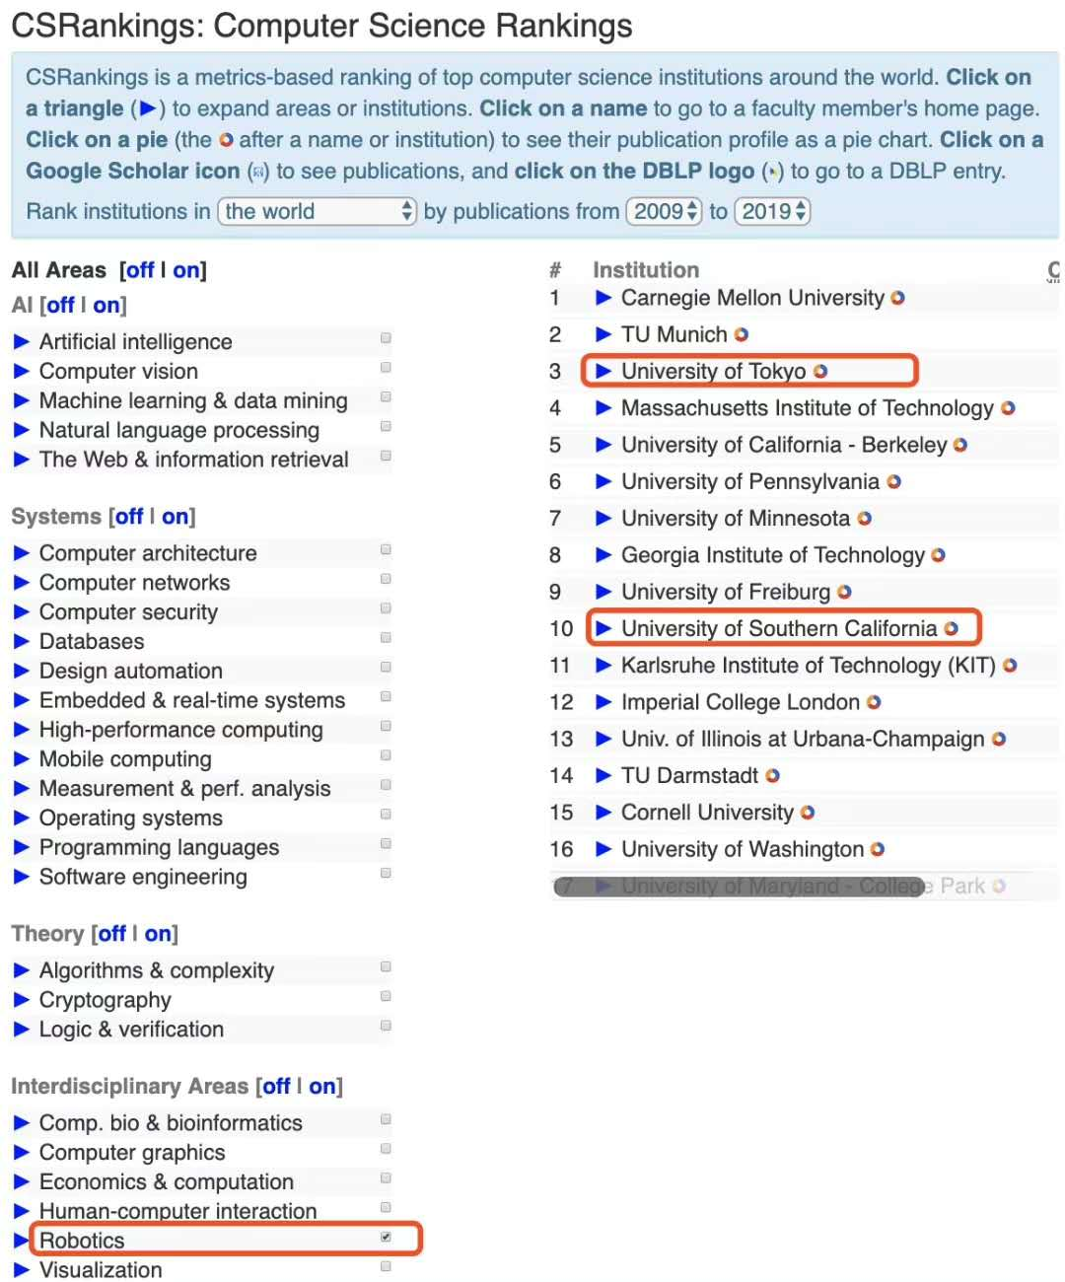
Selection

Slide 6
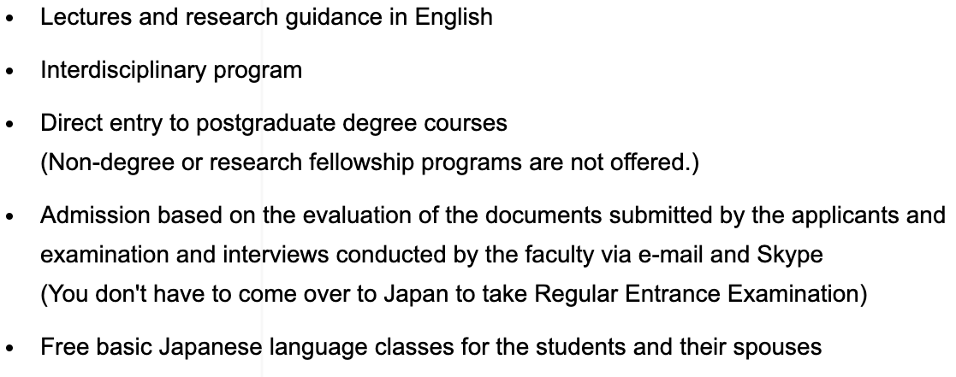
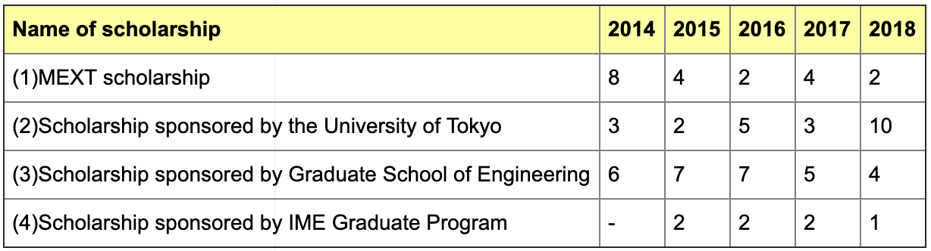
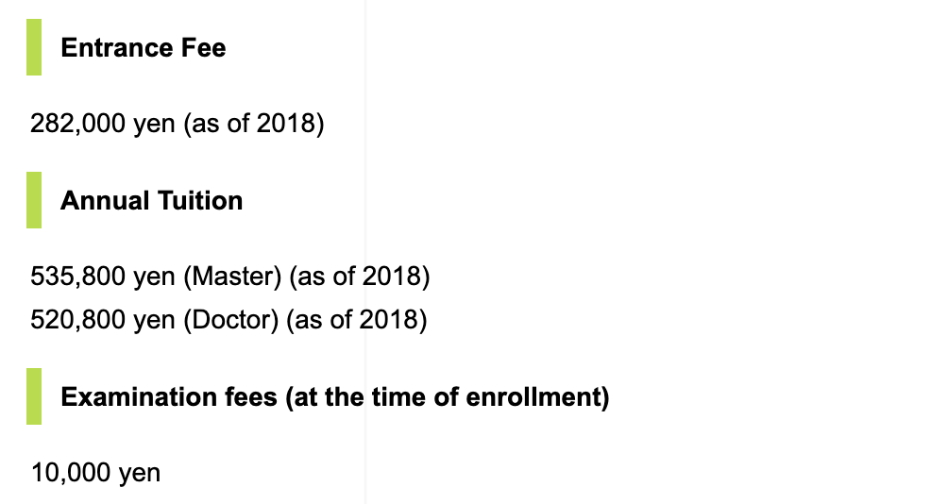
Final Decision:
The Univ. of Tokyo
Reputation: Several Nobel Prizes,
No.1 in Japan
wide range of course selection
rich work opportunities
Cost
Multiple Scholarships
MEXT Scholarship:
Airplane tickets
Exempt from Tuituion, Entrance Fee, exam Fees
Basic Monthly Stipend
Dormitory privilege

Slide 7
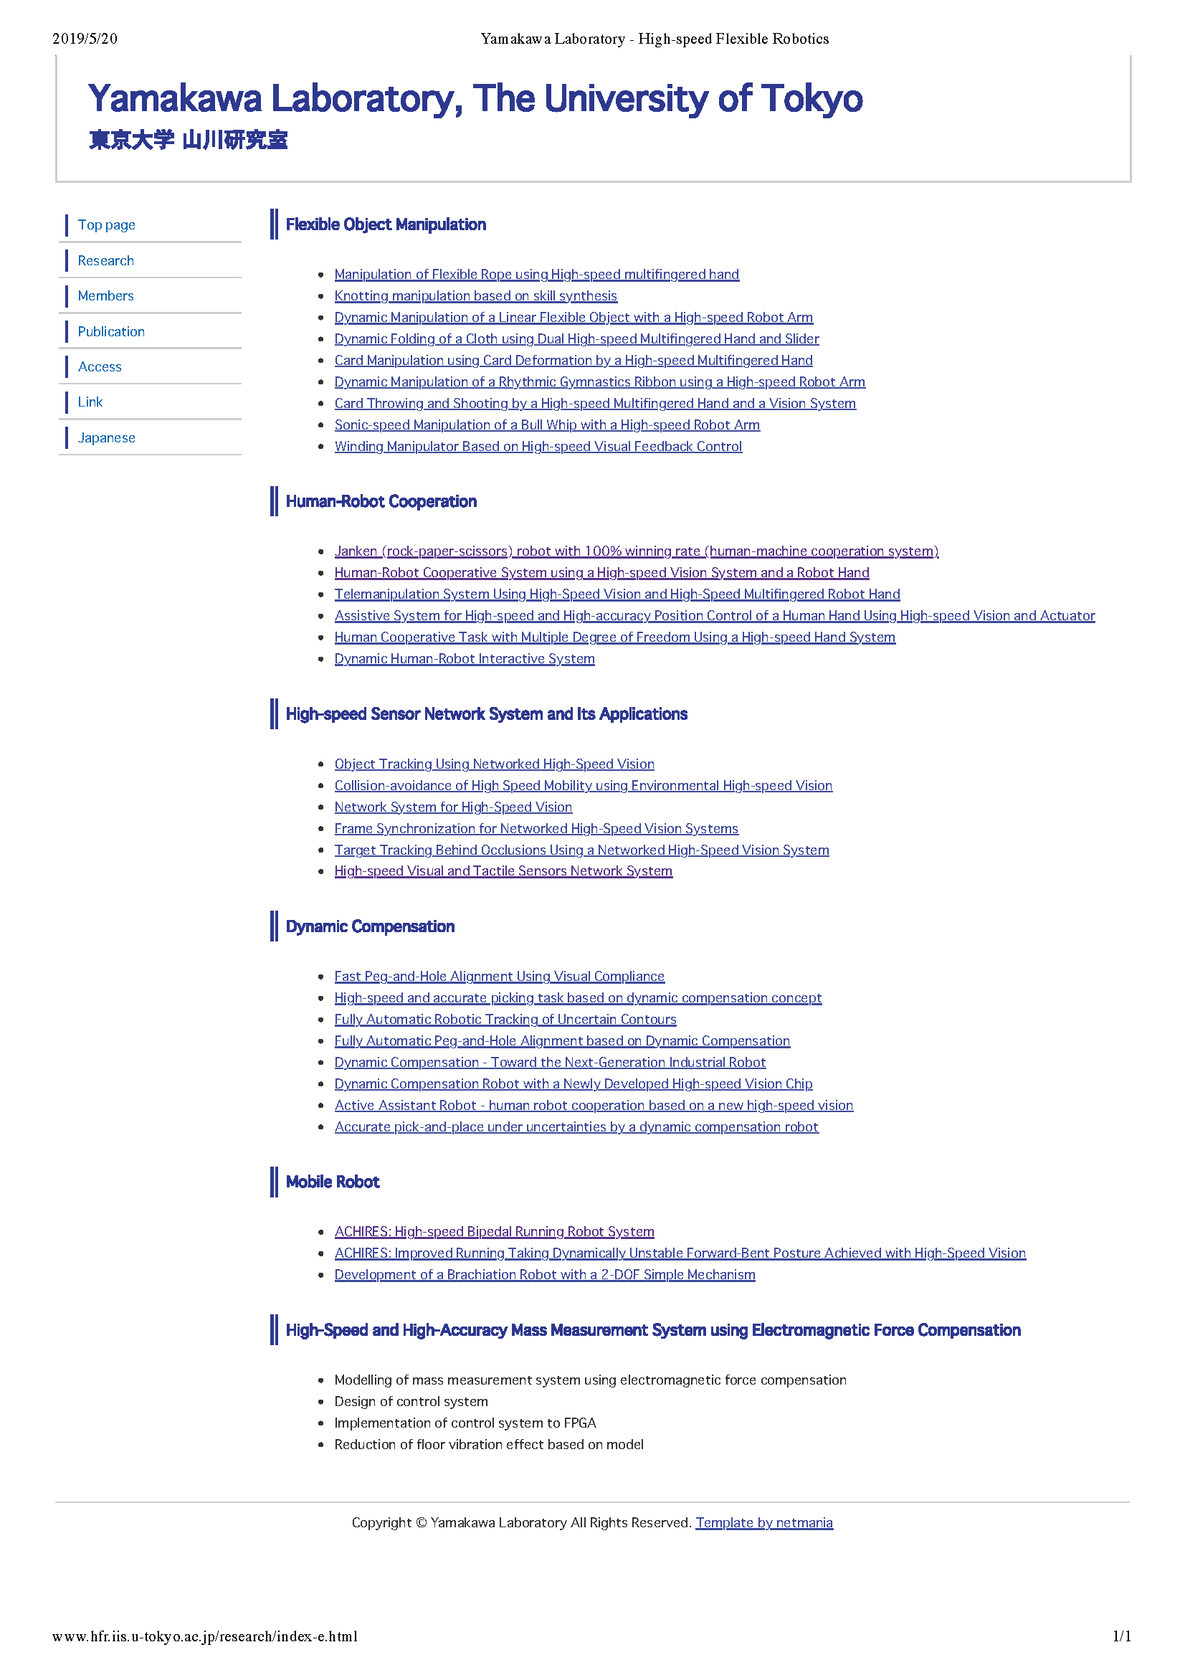
Research topic of my supervisor

Slide 8
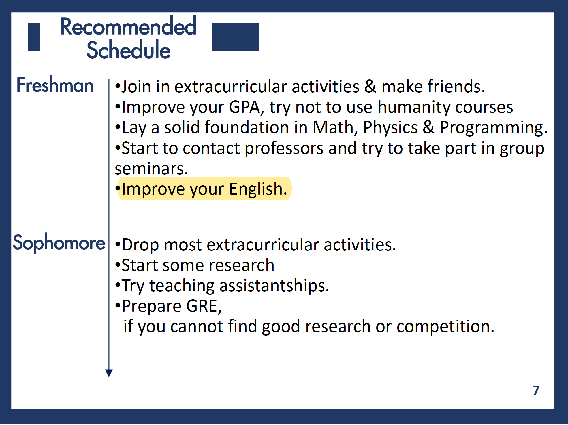

Slide 9
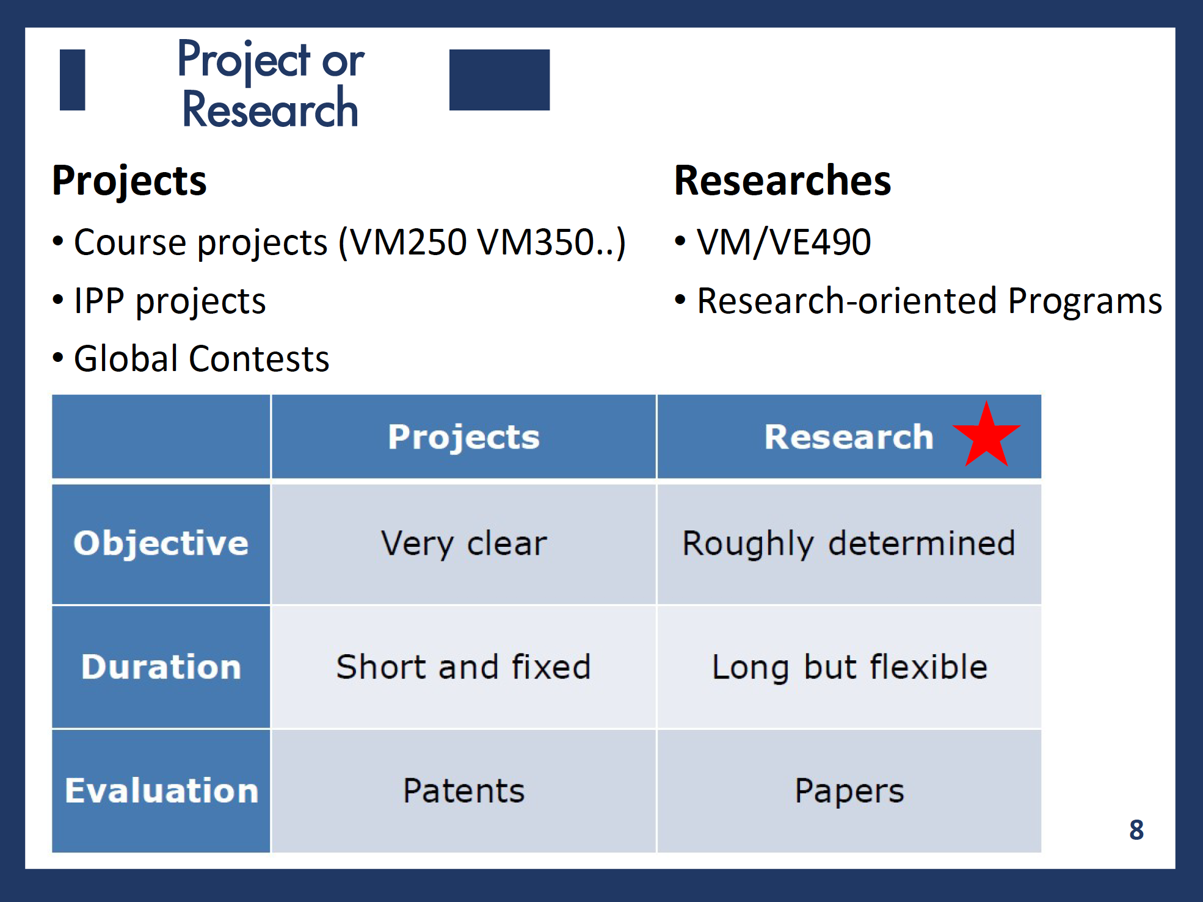

Slide 10
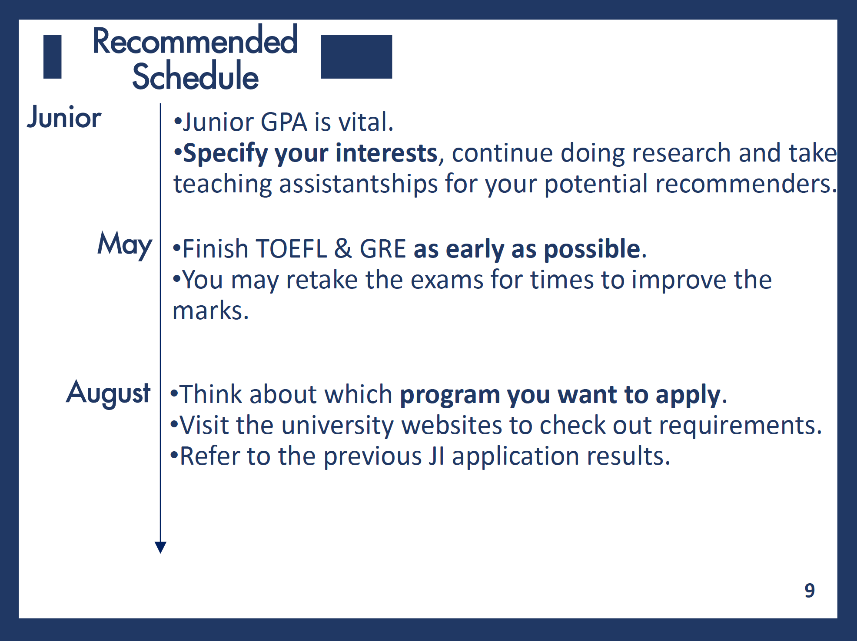

Slide 11
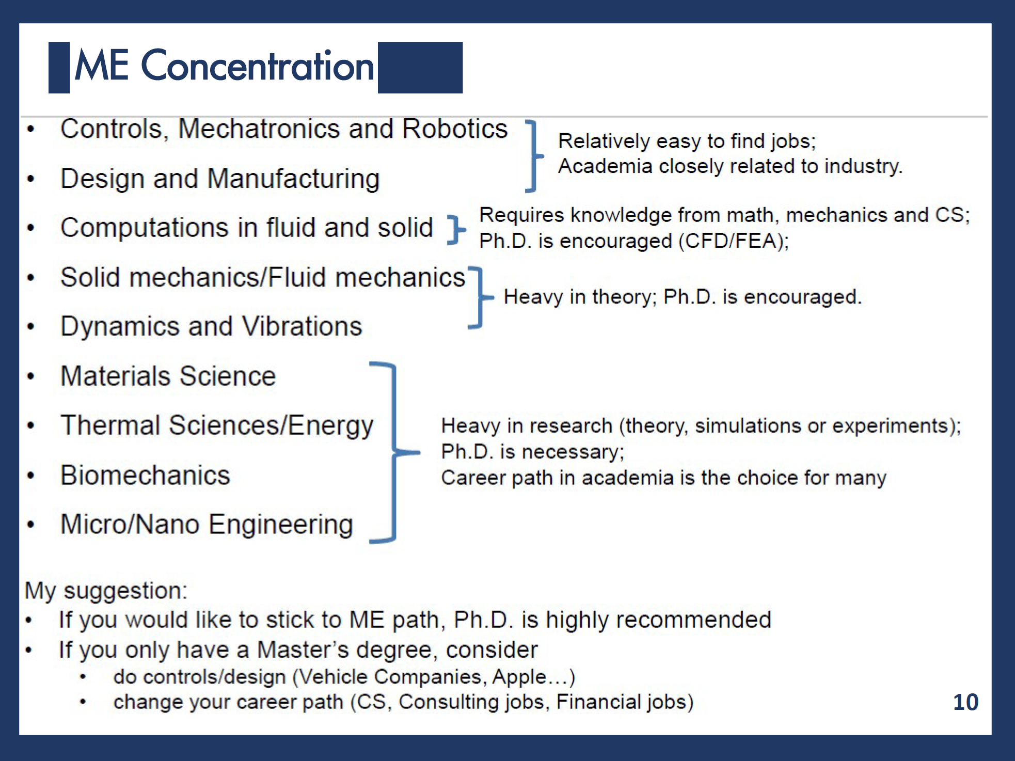

Slide 12
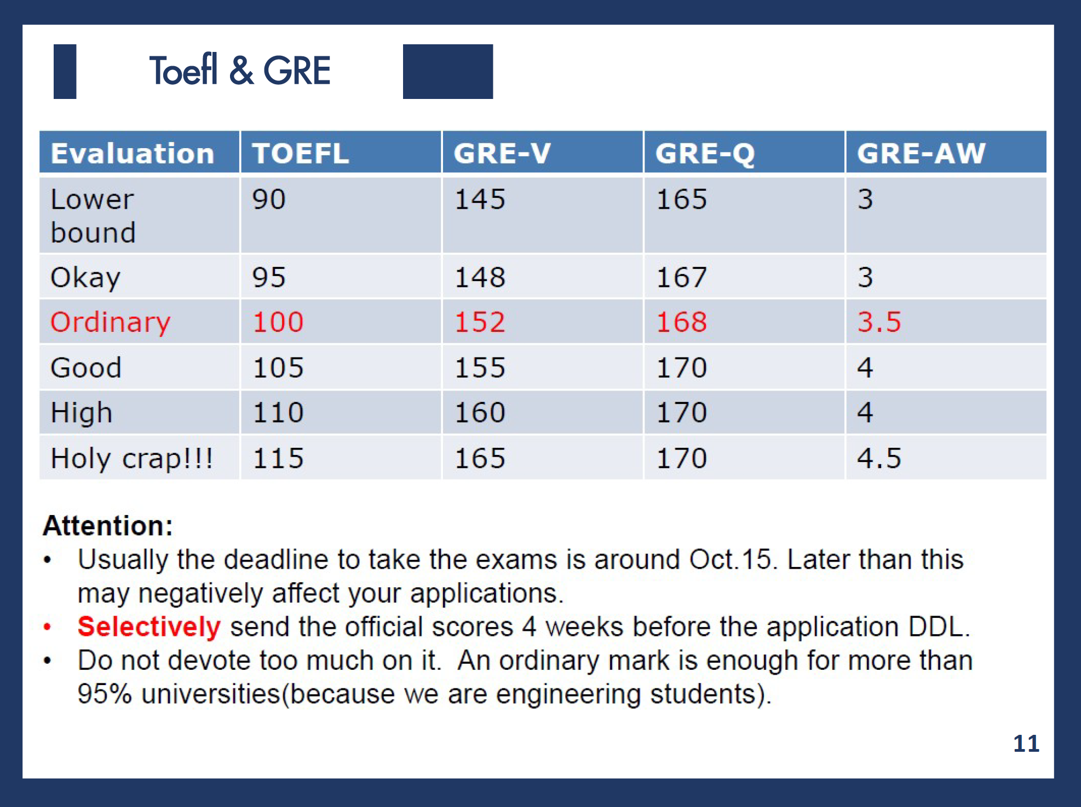

Slide 13
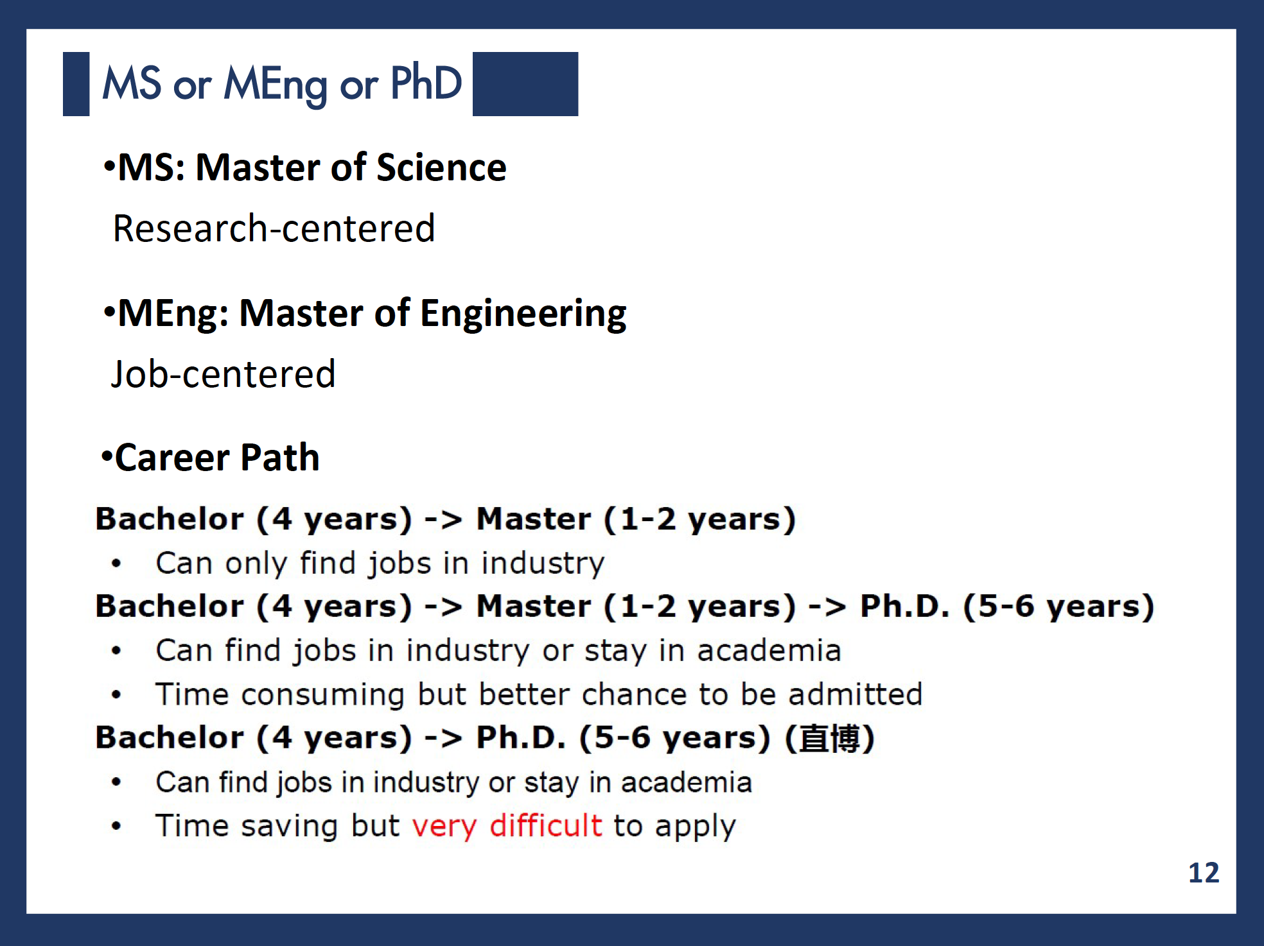

Slide 14
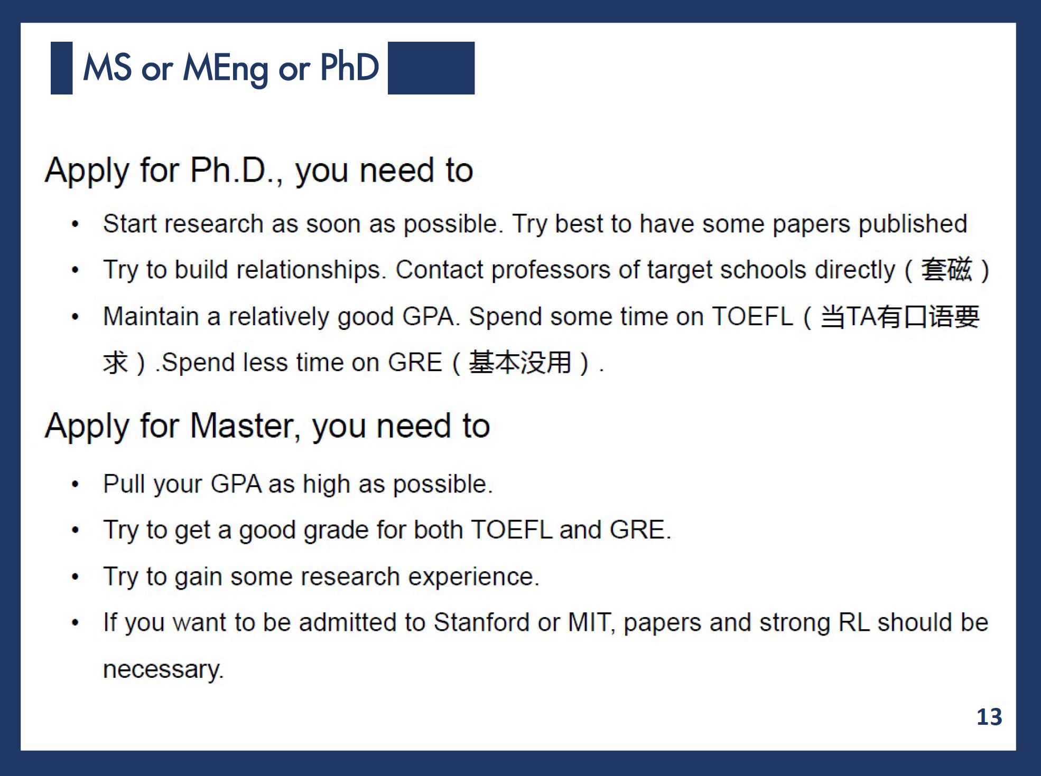

Slide 15
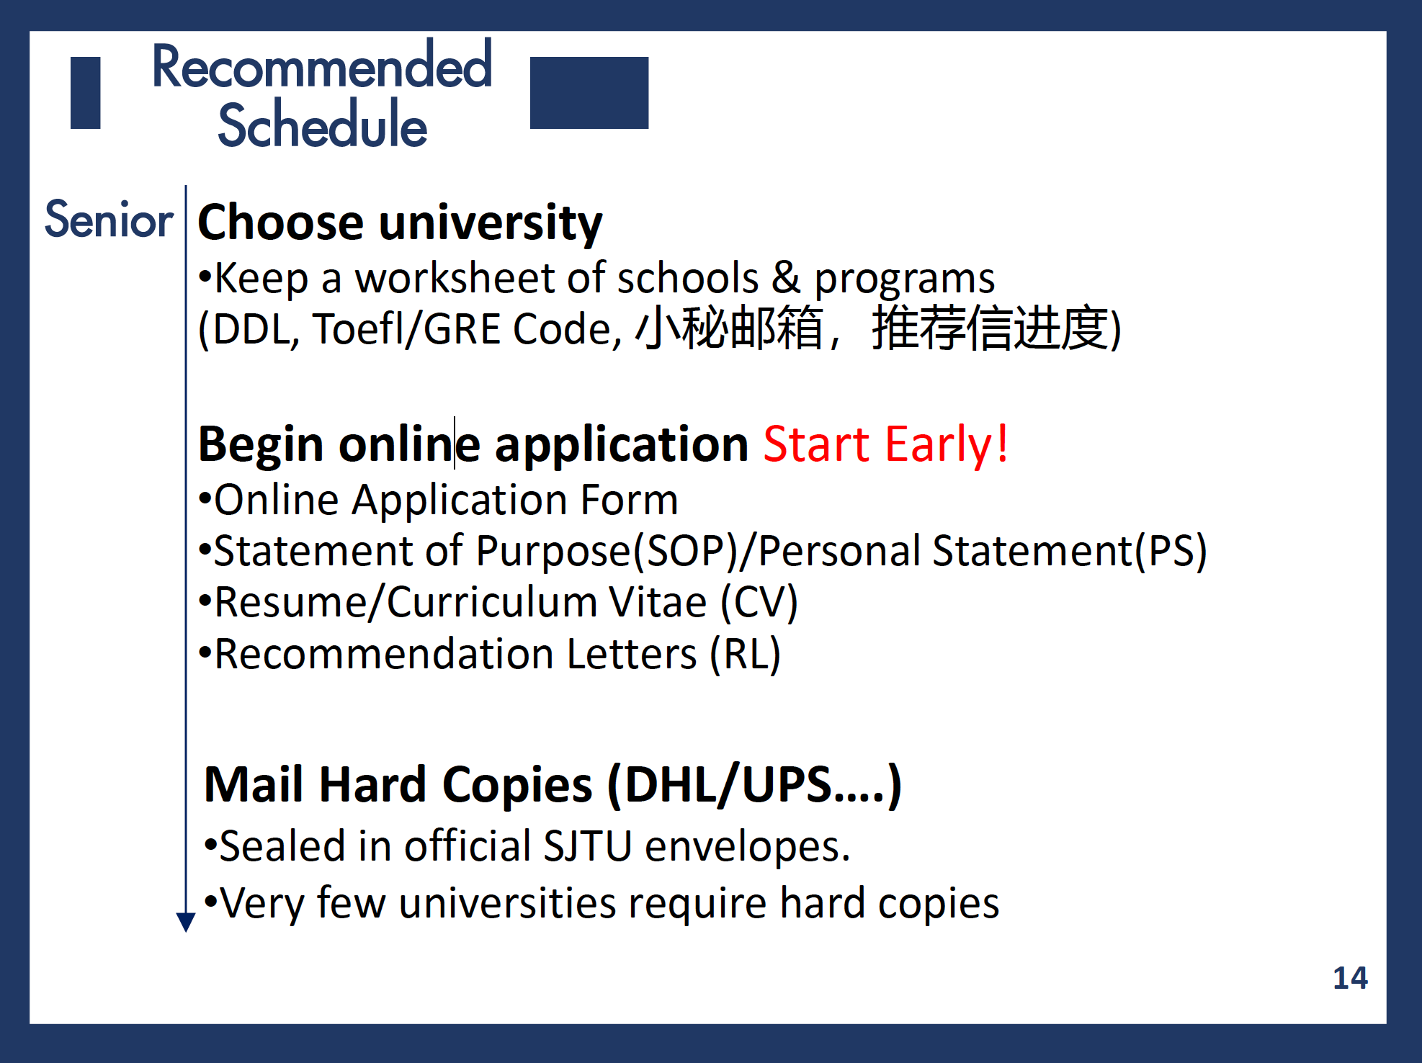

Slide 16
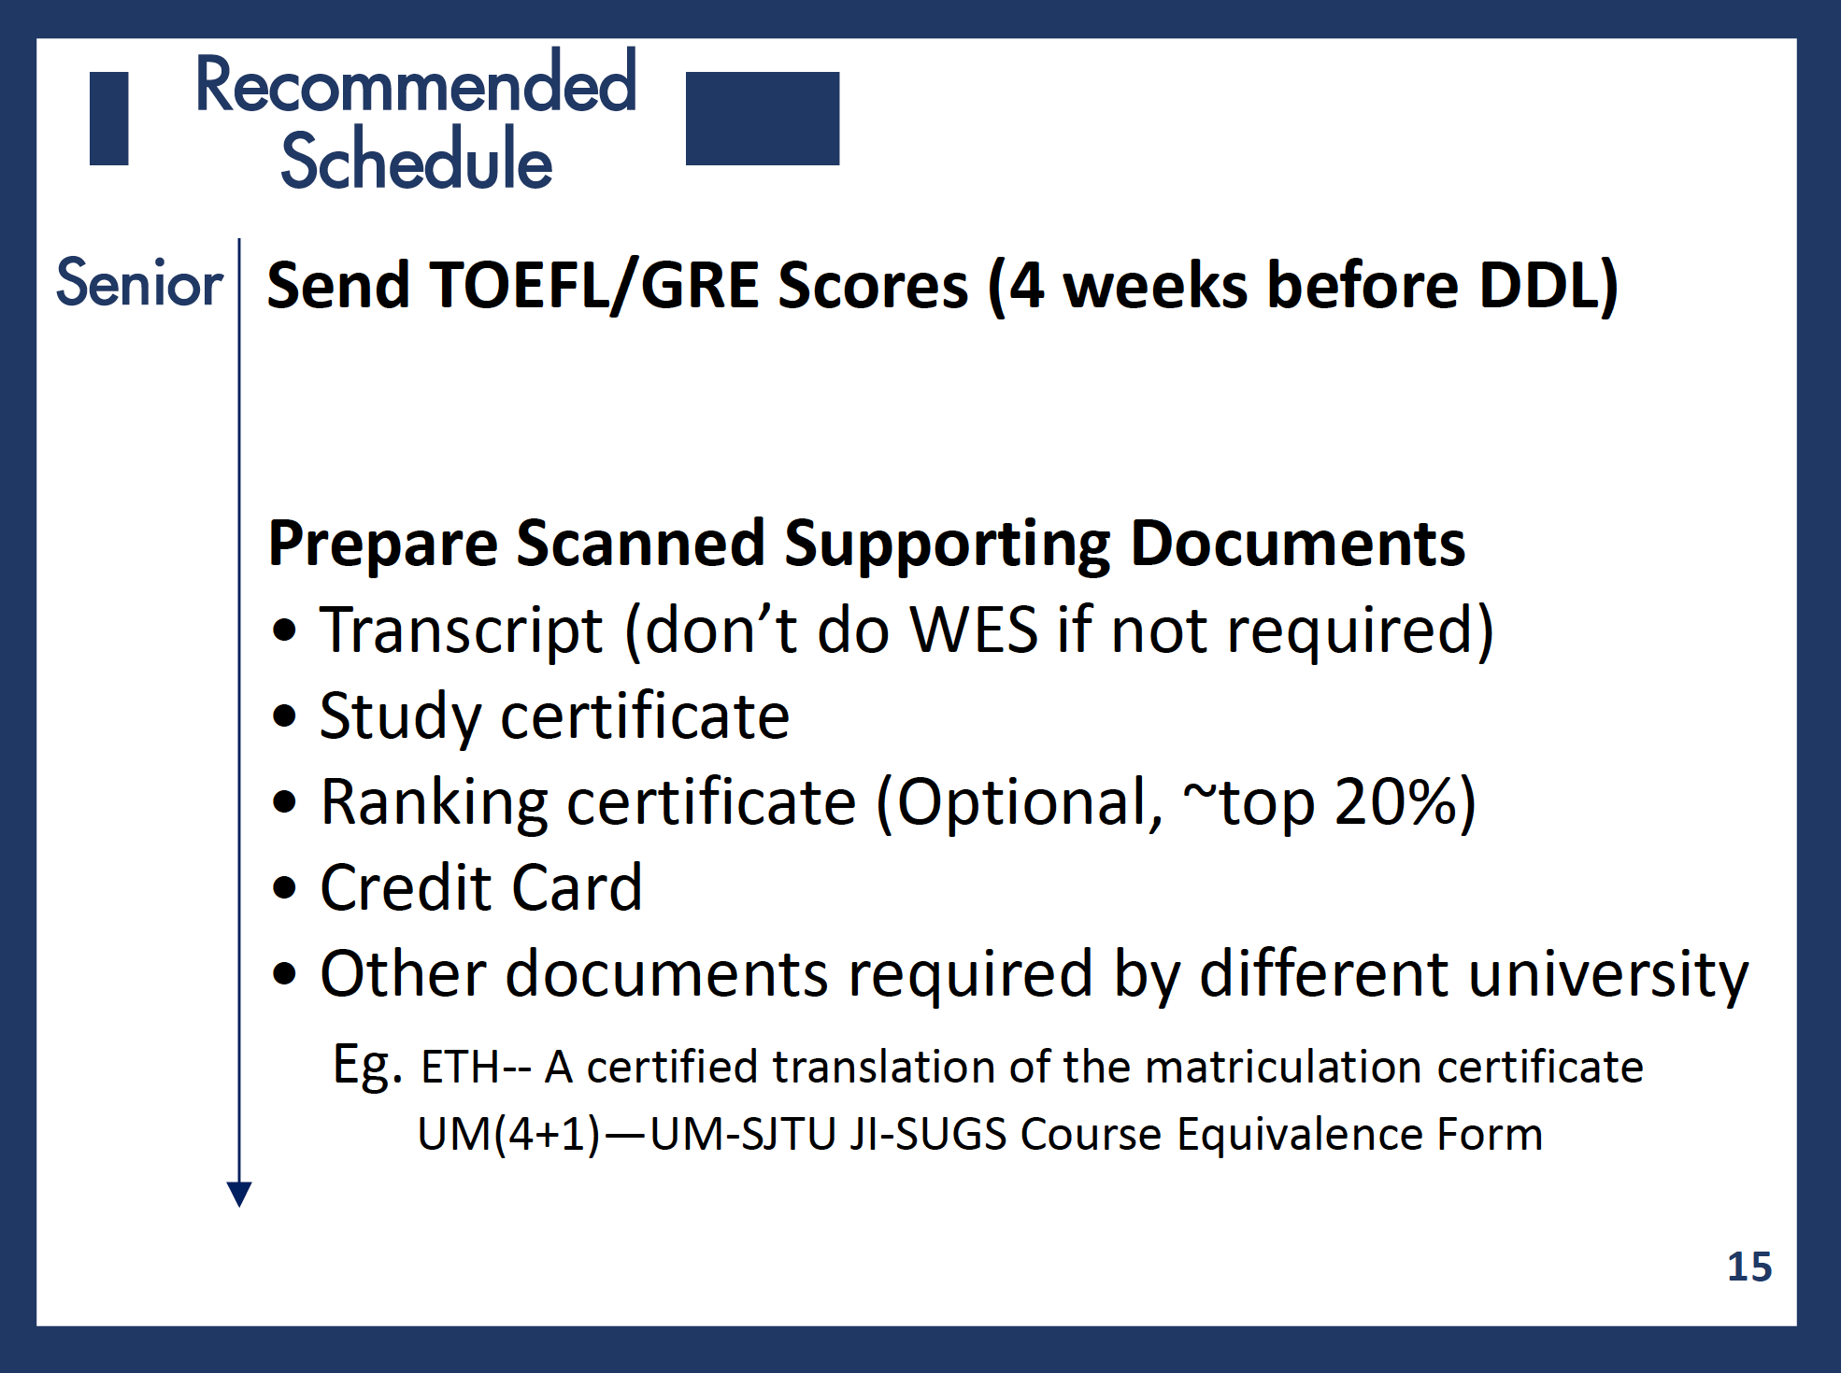

Slide 18
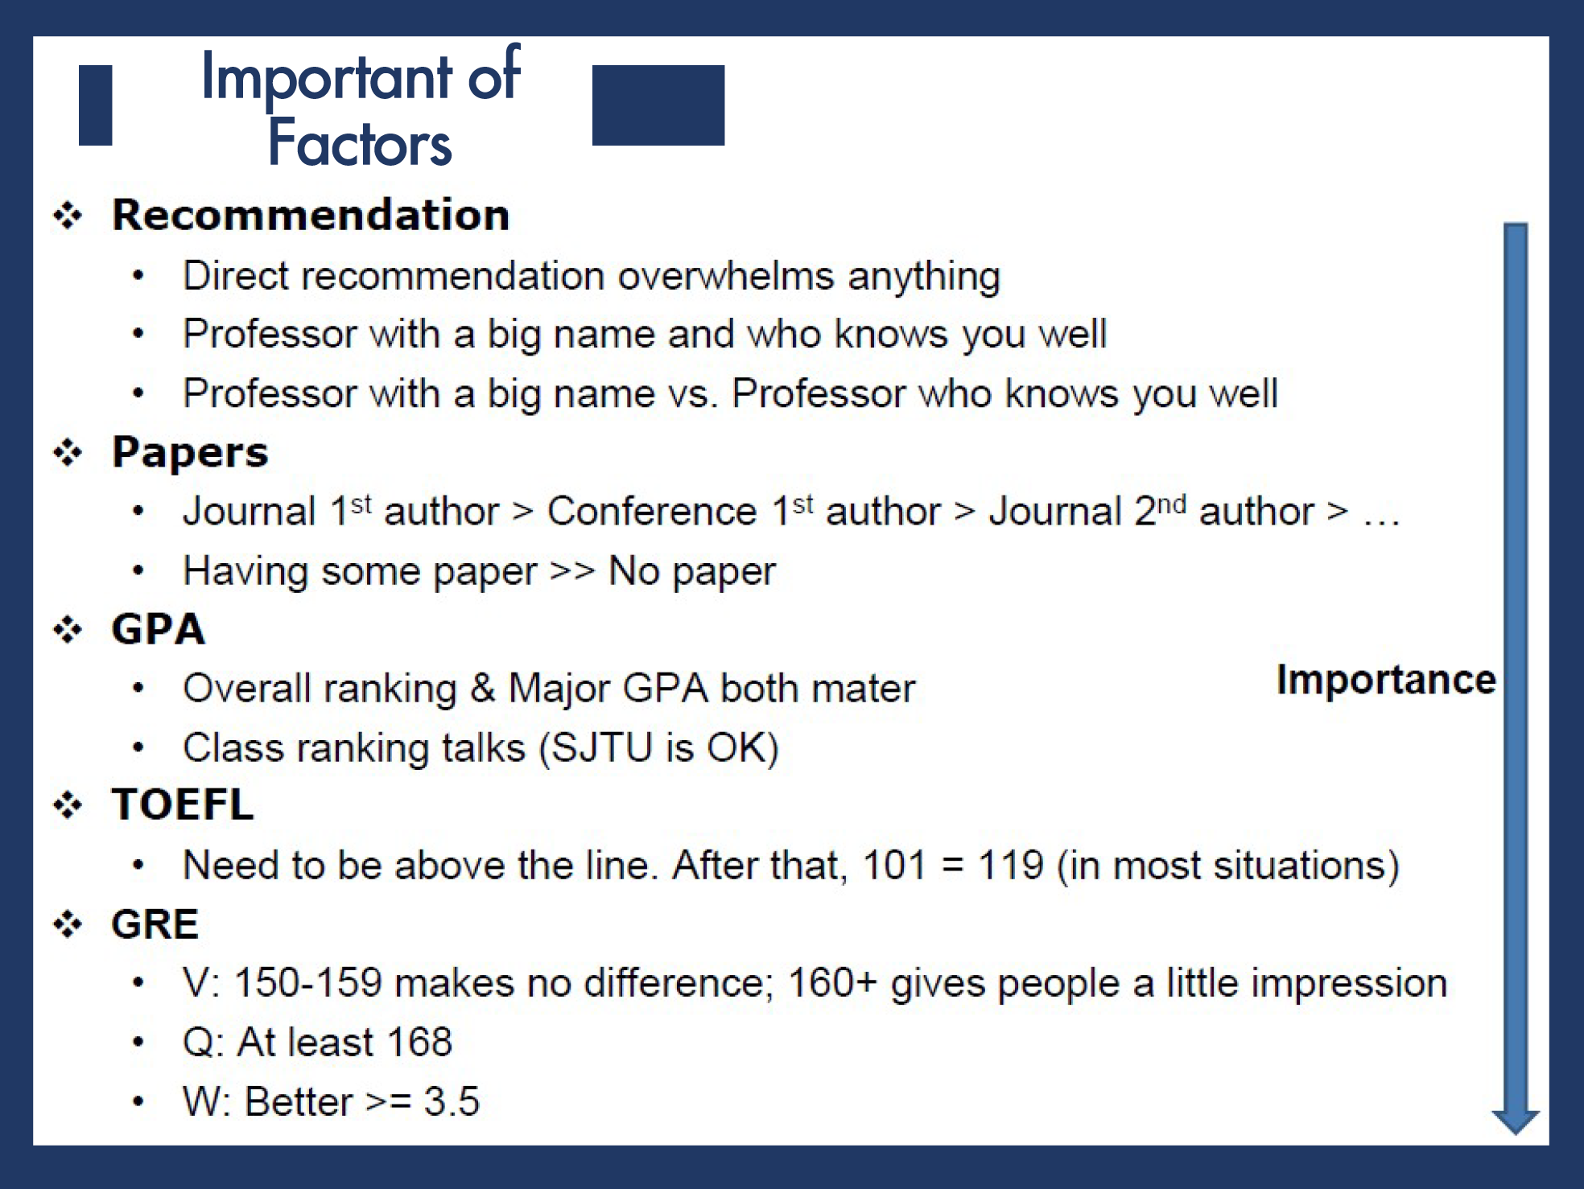

Slide 19
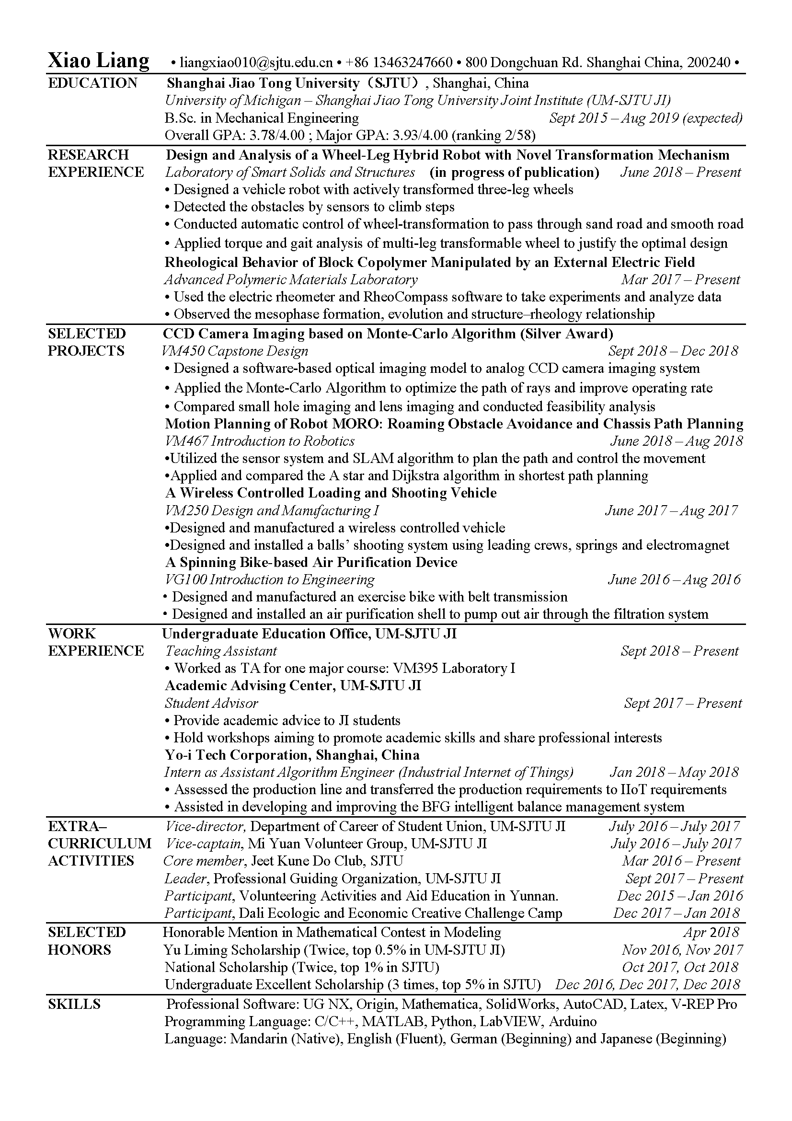
My CV

Slide 20
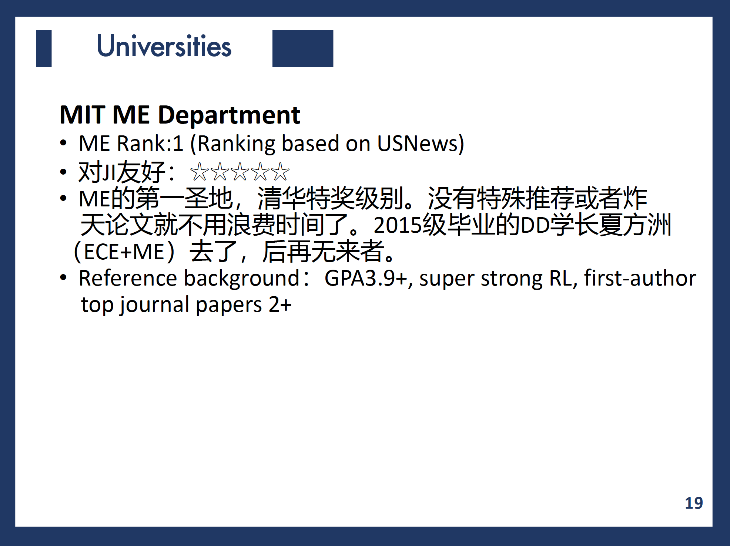

Slide 21
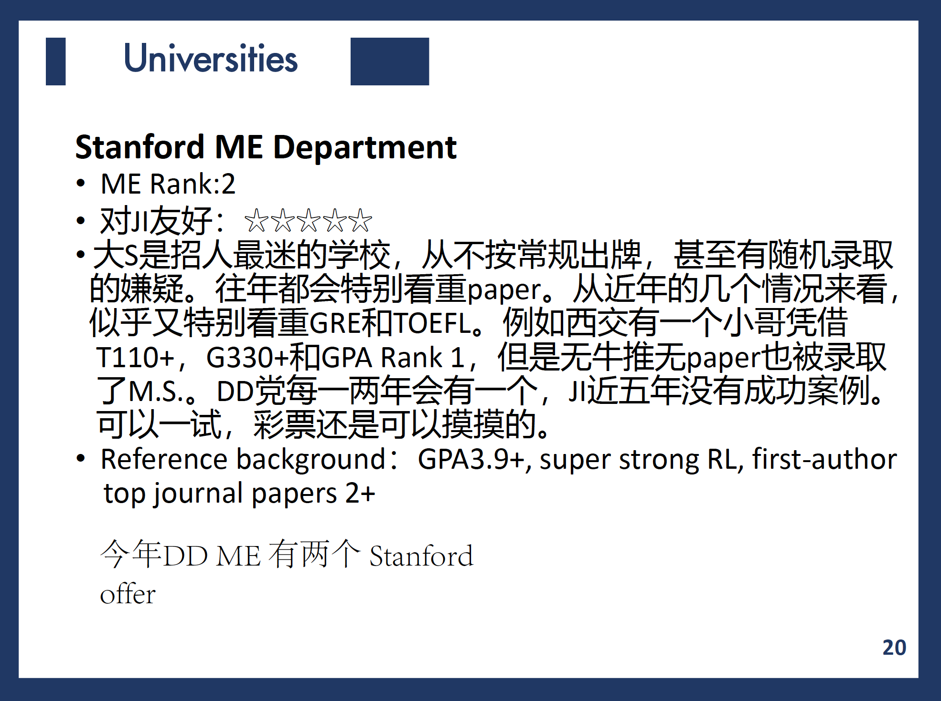
今年DD 3个stanford

Slide 22
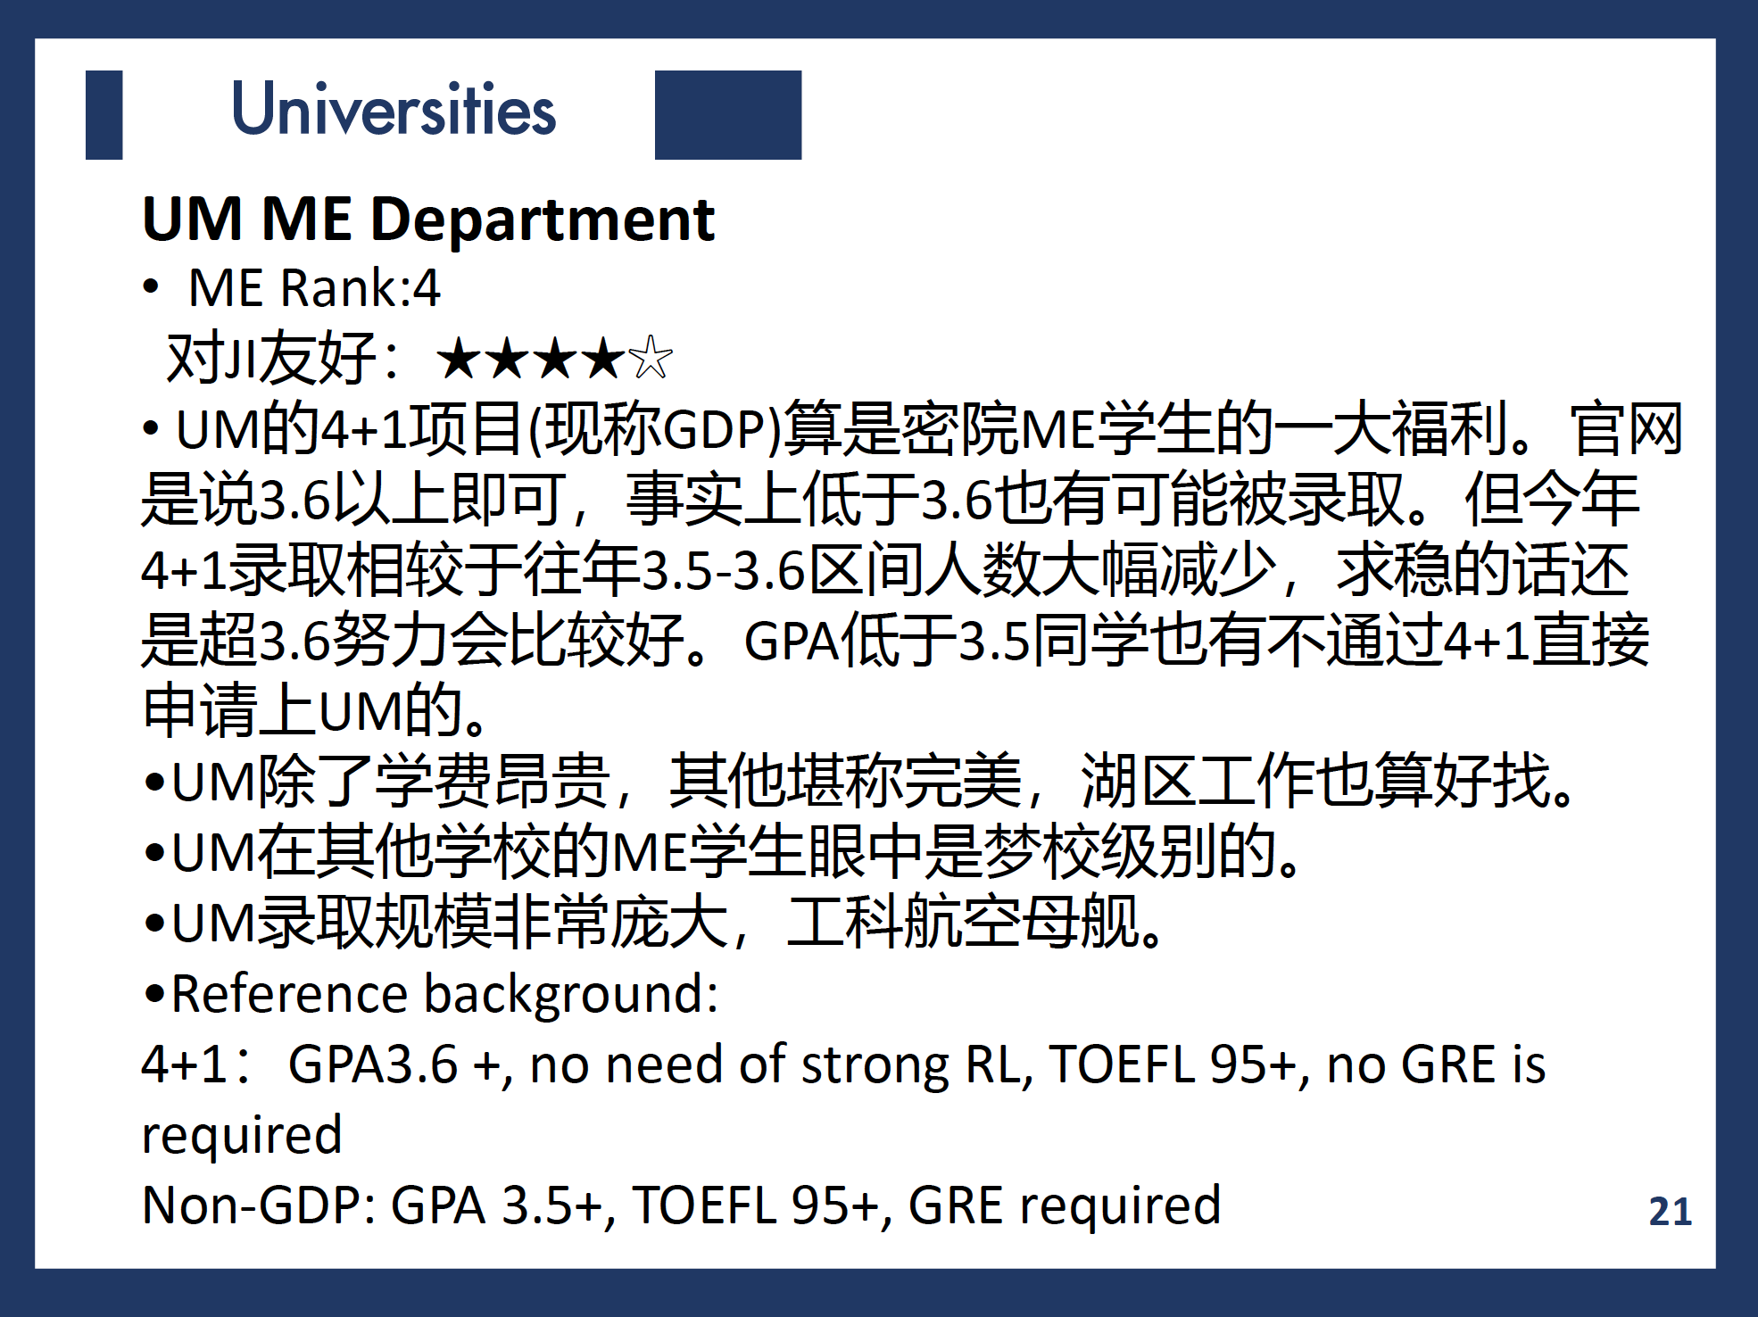

Slide 23
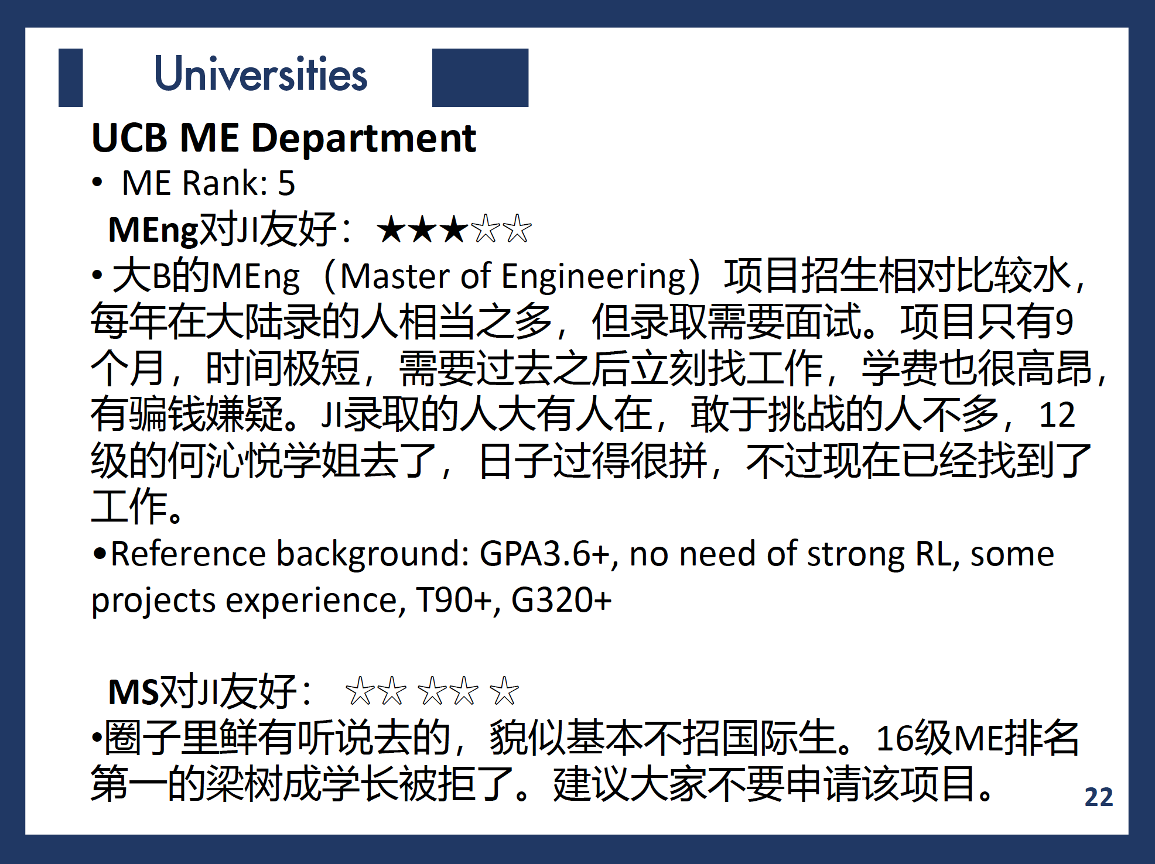

Slide 24
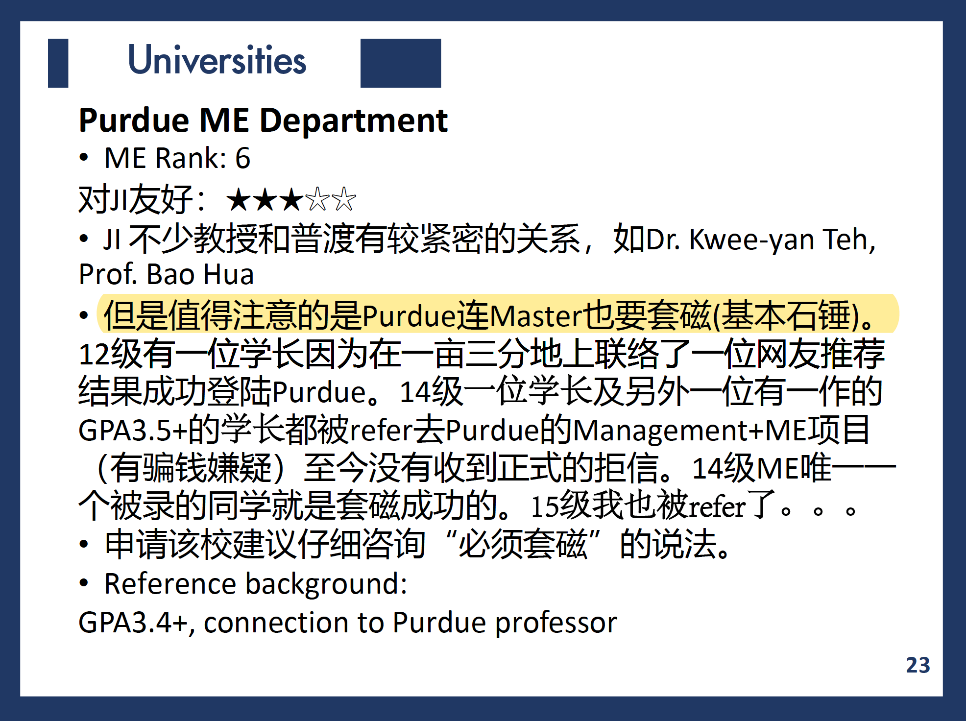

Slide 25
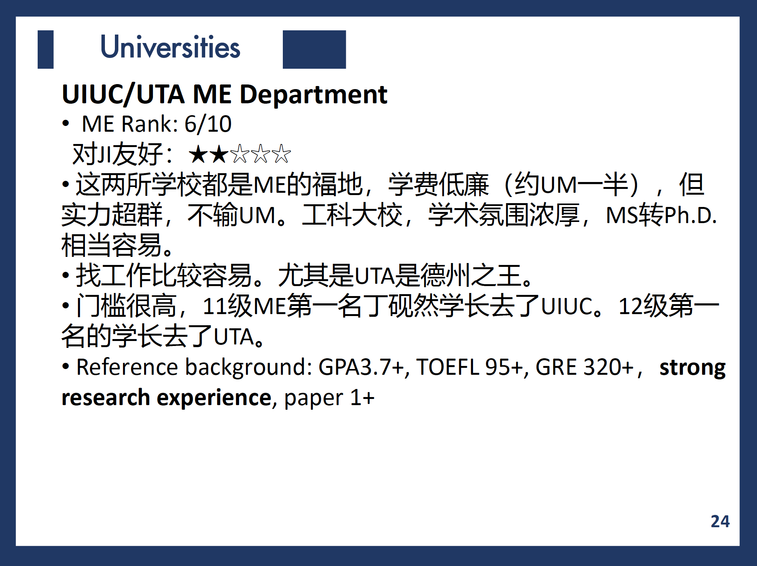

Slide 26
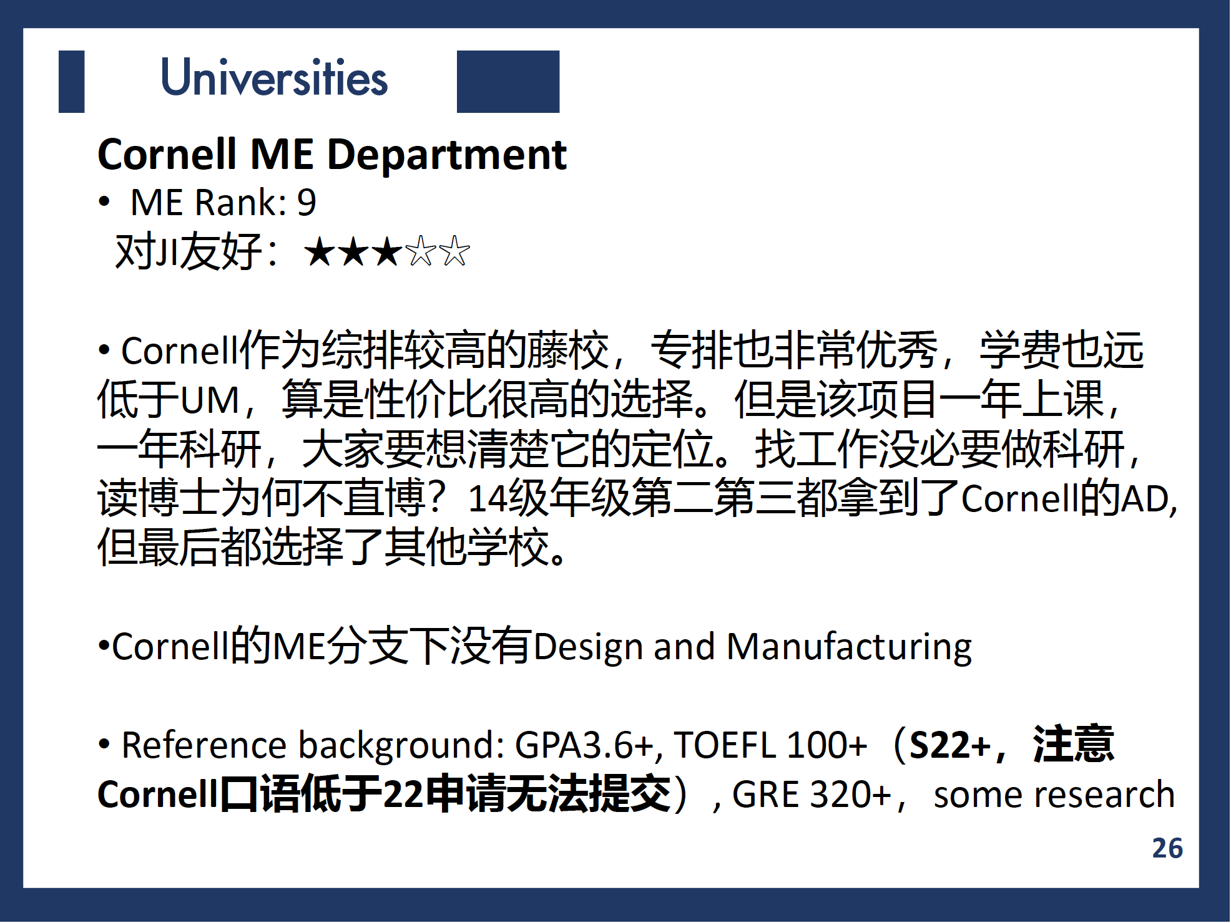

Slide 27
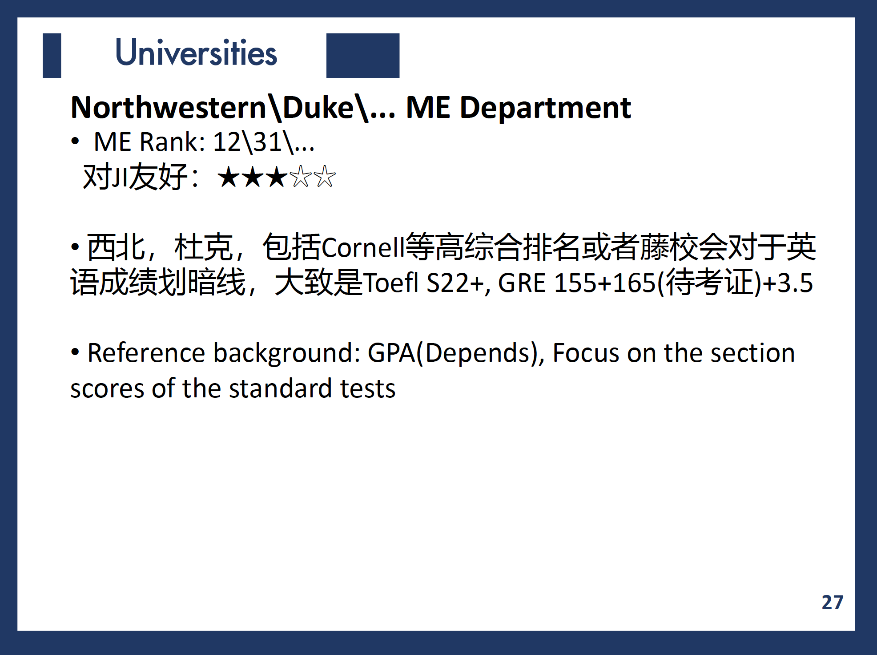

Slide 28
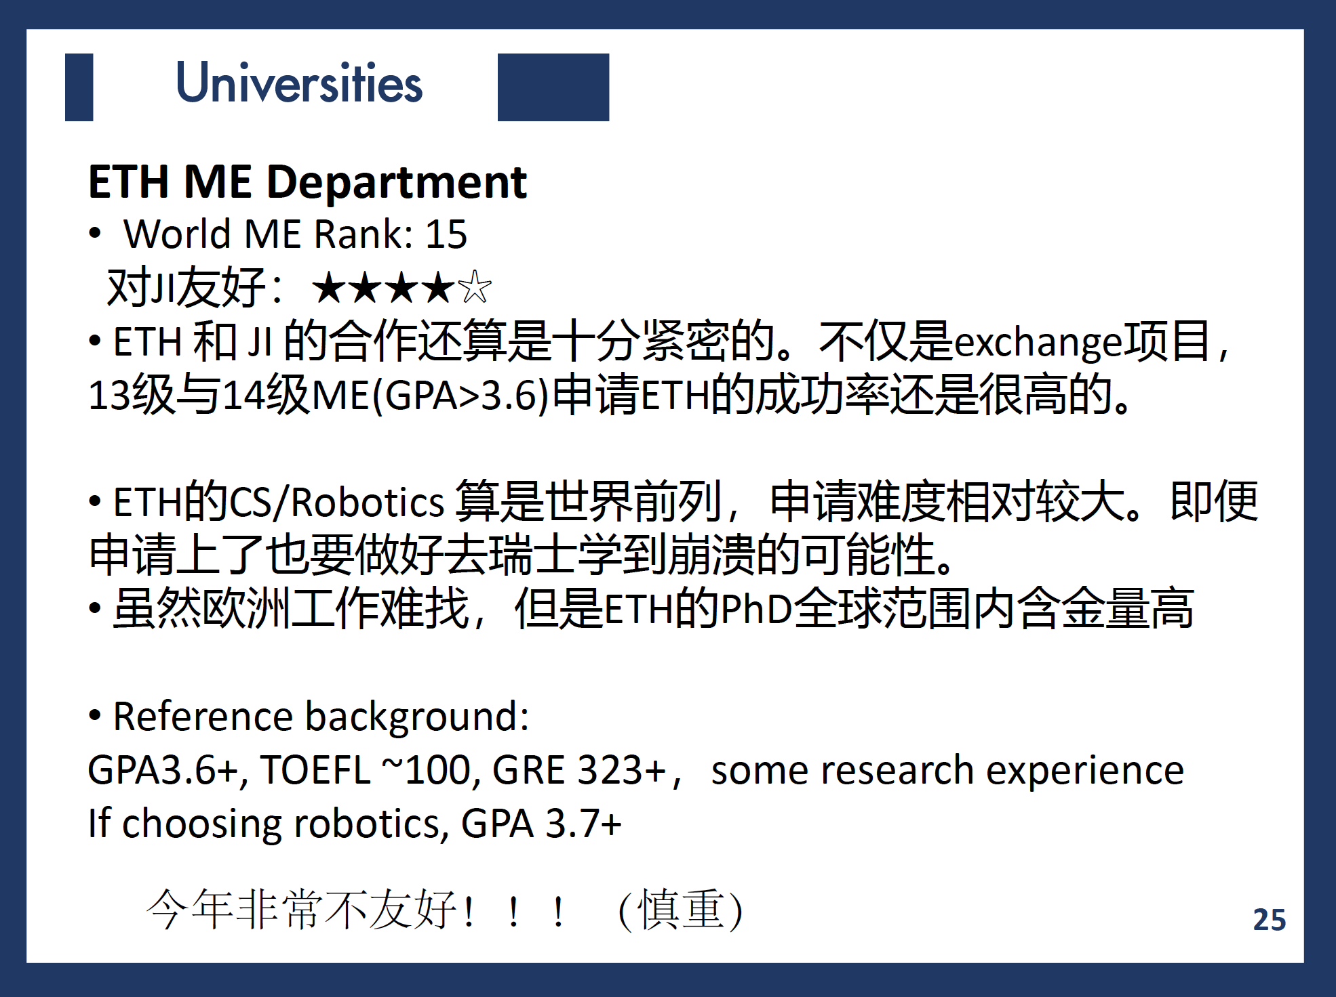

Slide 29
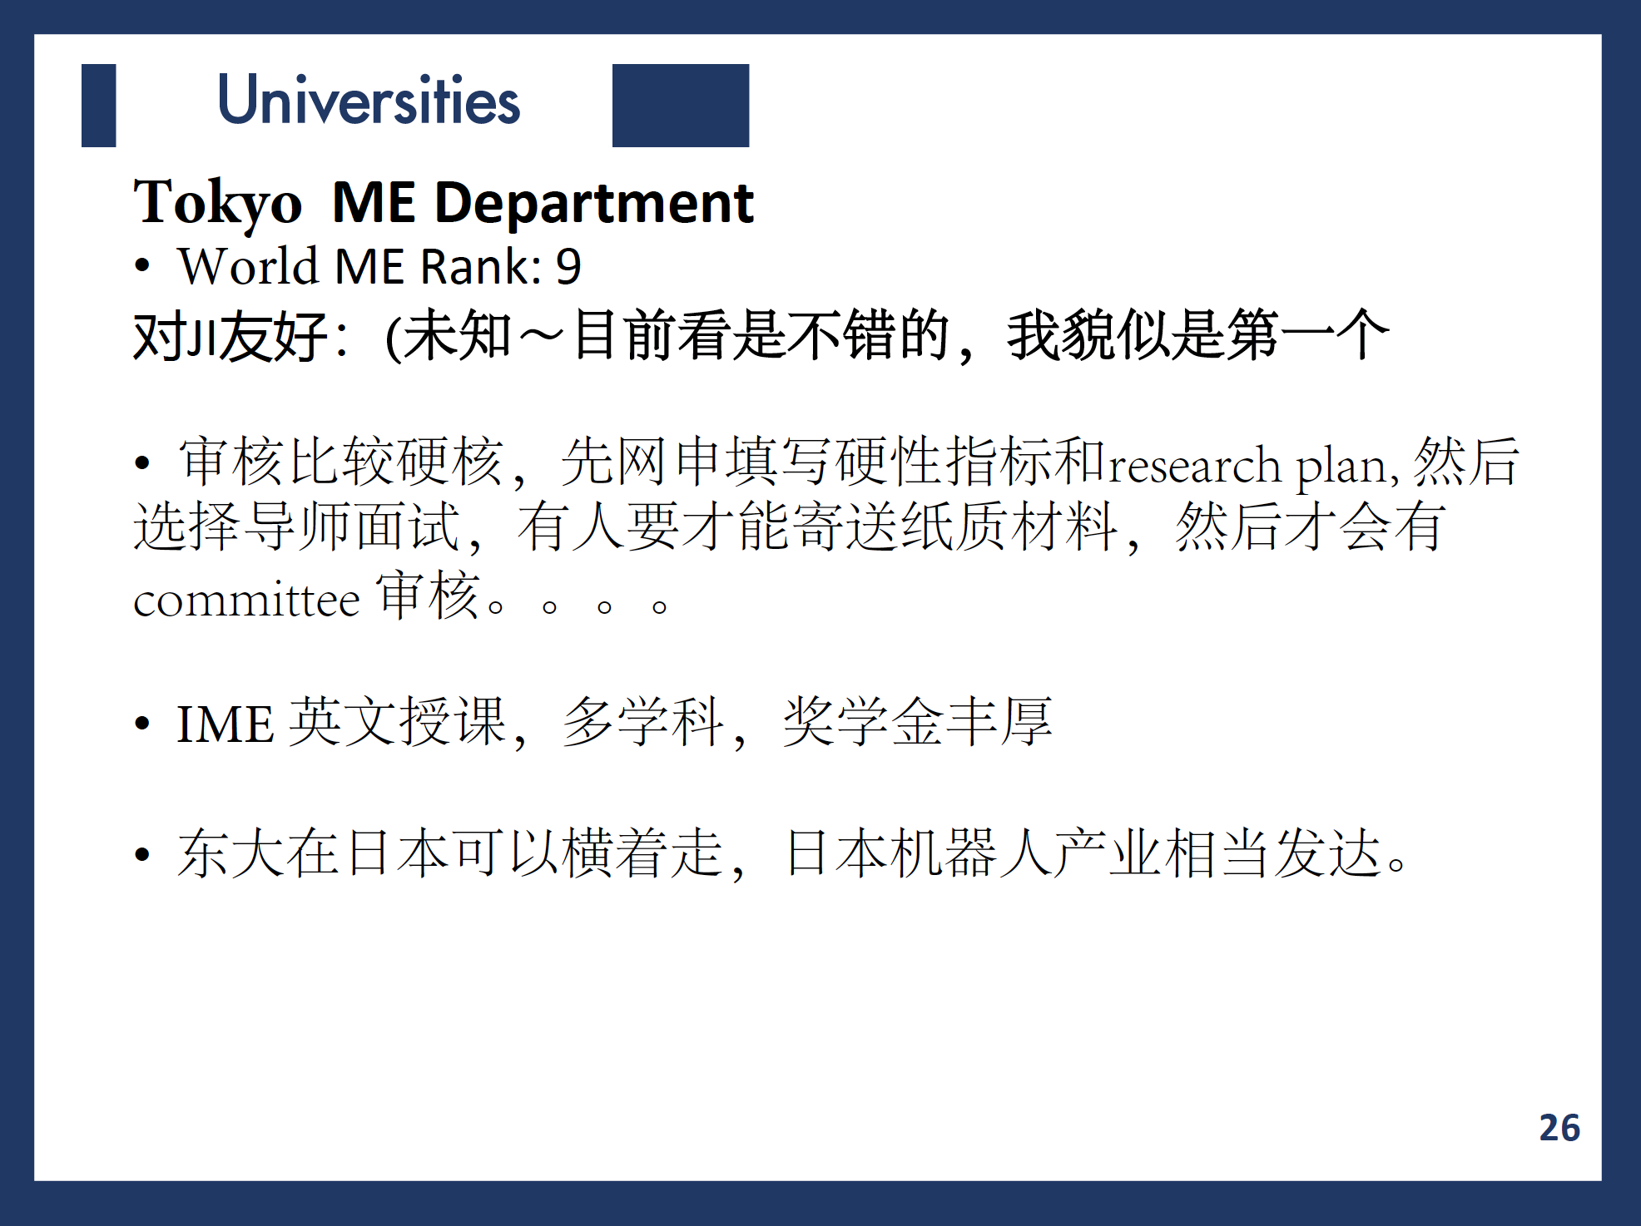

Slide 30
PS&SOP
statement of purpose(sop) 侧重点在purpose上，也就是进入graduate school program的目的，包括了你之前在此领域所学，所做。写研究背景，写未来规划。最后这个program为什么能满足你。 personal statement(ps) 侧重点在personal 目的是让committee充分了解你，力求最大限度展现自己。也就是让别人看到之后就能想象出你这个实实在在的人。可以包括经济情况，家庭情况，受教育情况，所在的地理位置，你将要拥有的机会，你曾经面对的挑战等。(这就是为什么很多美国人写的ps都像意识流) 可以没有固定格式 那么问题就来了。很多学校的申请只要求ps。有的只要求sop。而更有甚者要求both ps and sop!?
Pay attention：在一定程度上 ps=sop。那么我们就可以做出一个判断了，也就是说理科如果被要求了ps而不是sop， 是应该按照sop来写的，也就是专业领域的相关以及未来规划。

Slide 31
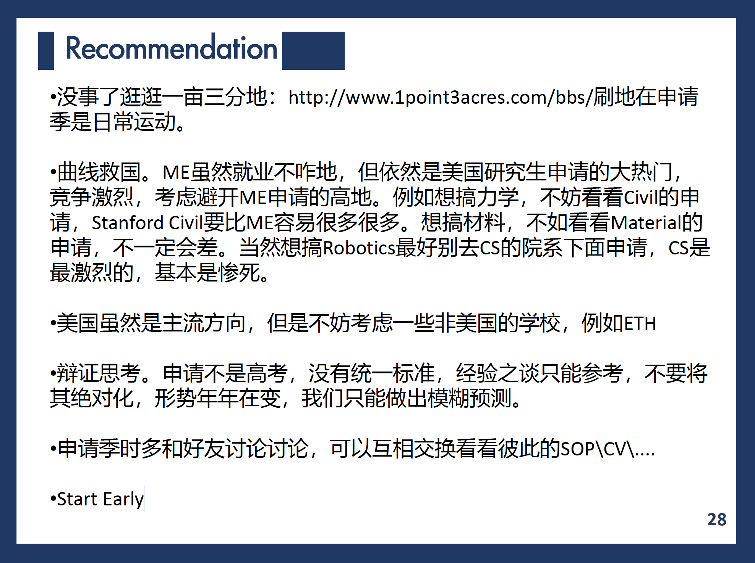

Slide 32
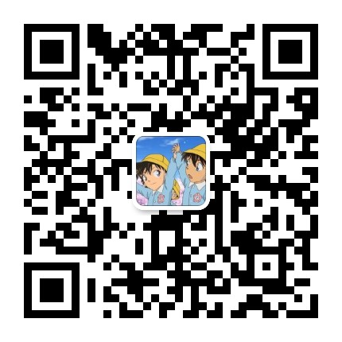
Thank you!
liangxiao010@sjtu.edu.cn

Slide 33
申请后的反思：
择校应该更大胆一点 ；
早点准备英语；
应该参加交换项目；
应该做一次有意义有难度有成果的长期的科研；
应该好好构思文书（sop ps 的独特性和突出重点真的很重要，这也是中介能提供的的最有用的服务）

